Slide 1

Inventory Management System
An inventory management system is designed to streamline your organization's inventory processes, enhancing efficiency and visibility across all stages of the supply chain

Slide 2

Key Features
1
Real-Time Tracking
2
Automated Alerts
Gain instant visibility into your inventory levels, allowing you to make informed decisions and prevent stockouts.
Receive timely notifications about low stock, expiring items, and other critical events, ensuring proactive management.
3
Centralized Data
4
User-Friendly Interface
Maintain a unified database of all inventory information, eliminating inconsistencies and improving data accuracy.
Navigate the system effortlessly with intuitive menus, dashboards, and customizable reports.

Slide 3
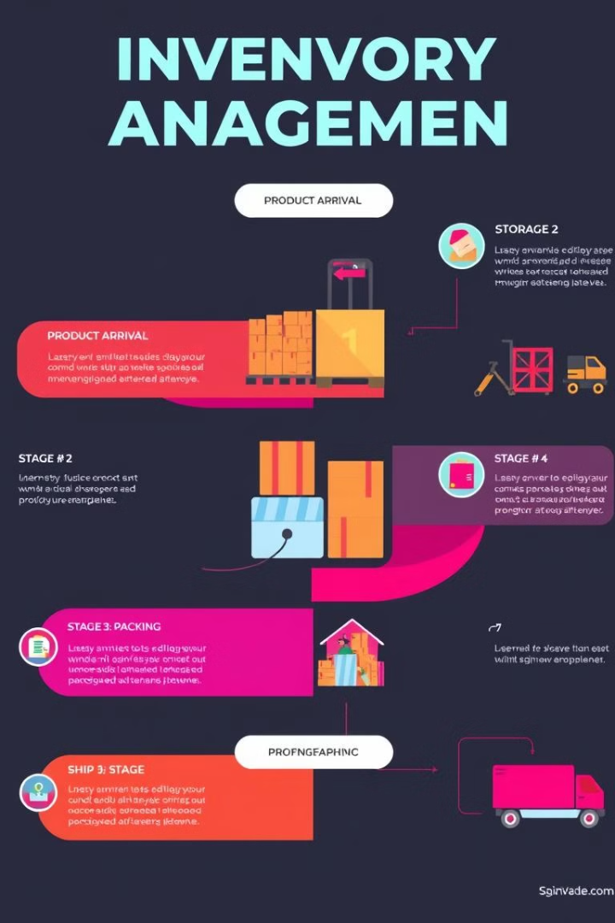
Inventory Tracking
1
Receiving
Track incoming shipments, verify quantities, and update inventory levels accurately.
2
Storage
Manage warehouse space effectively, optimize storage locations, and ensure proper handling of goods.
3
Picking and Packing
Streamline order fulfillment processes by tracking stock availability, creating picking lists, and ensuring accurate packing.
4
Shipping
Monitor outgoing shipments, generate tracking numbers, and provide customers with real-time updates.

Slide 4
Demand Forecasting
Historical Data Analysis
Predictive Models
Optimized Inventory Planning
Utilize advanced algorithms to forecast future demand, taking into account historical data, market trends, and external factors.
Leverage past sales data to identify seasonal trends, demand patterns, and other factors influencing sales.
Balance supply and demand effectively by adjusting stock levels based on accurate demand forecasts, minimizing waste and maximizing profitability.

Slide 5





Automated Reordering
Set Reorder Points
Define specific thresholds for each product, triggering automatic reordering when stock levels fall below a certain point.
Automated Purchase Orders
The system automatically generates purchase orders for suppliers based on predefined reorder points and stock levels.
Vendor Management
Integrate with vendor systems to manage inventory flow and ensure timely delivery of goods.
Stock Level Optimization
Prevent overstocking and stockouts by adjusting reorder points based on demand fluctuations and lead times.

Slide 6
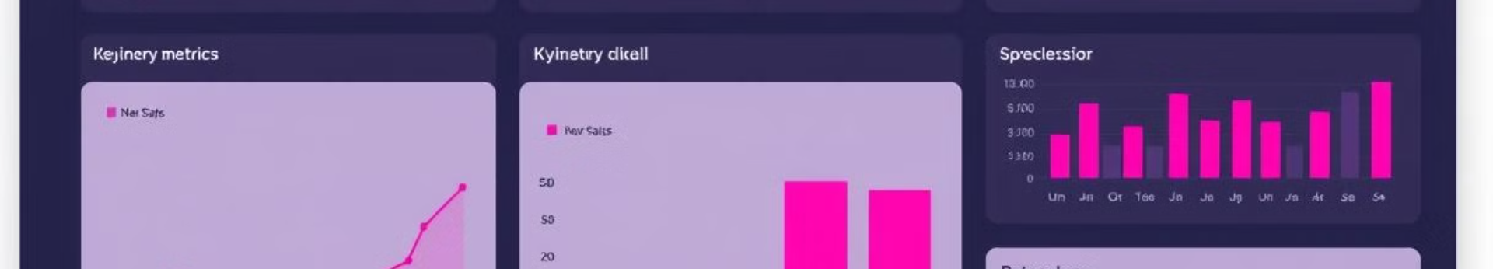
Reporting and Analytics
Inventory Turnover
Track the rate at which inventory is sold and replenished.
Sales Performance
Analyze sales trends, identify top-selling products, and measure customer demand.
Stock Levels
Monitor inventory levels across different locations and product categories.
Lead Times
Track the time it takes for suppliers to deliver goods, ensuring timely restocking.

Slide 7
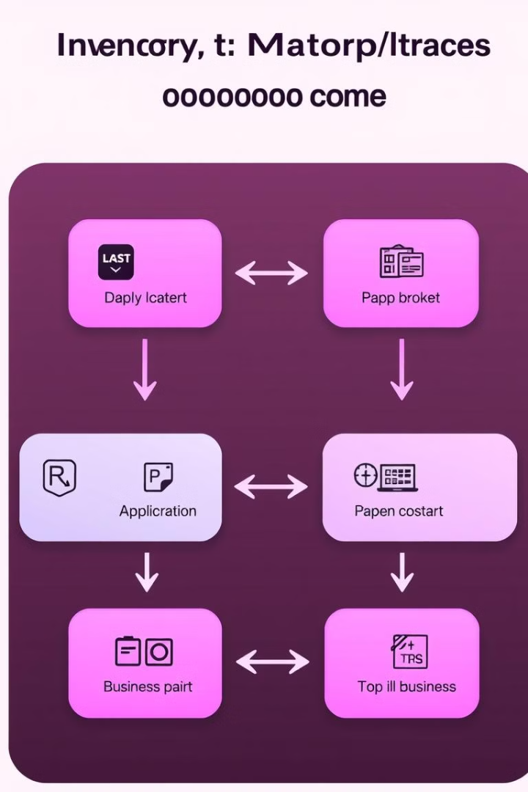


Integrations
E-commerce Platforms
Accounting Software
Sync inventory levels with online stores, ensuring accurate product availability and seamless order fulfillment.
Automate inventory-related transactions, improving financial accuracy and reducing manual data entry.
Shipping Carriers
Customer Relationship Management
Integrate with shipping platforms to generate labels, track shipments, and provide real-time delivery updates.
Connect with CRM systems to access customer data, personalize interactions, and provide relevant product recommendations.

Slide 8

Conclusion
By adopting an effective inventory management system, organizations can gain significant advantages, including improved efficiency, reduced costs, enhanced customer satisfaction, and increased profitability.

Slide 9

References
For further information on inventory management systems, consult reputable resources such as industry publications, research reports, and online forums.

